Slide 1
Internship Studio
Ethical Hacking Internship
Task-2 Solution

Slide 2
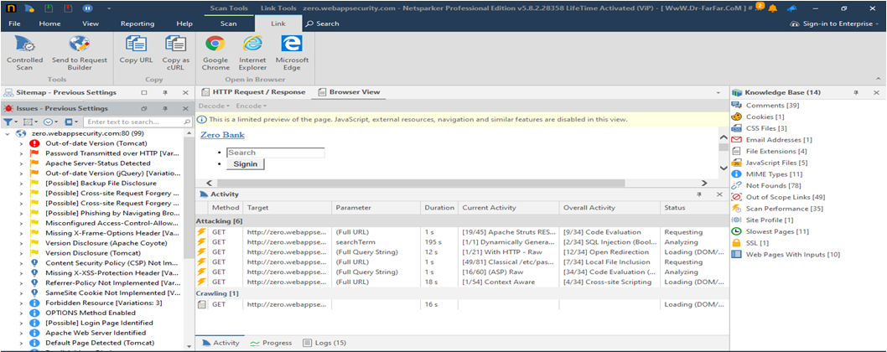
Netsparker Found Vulnerabilities

Slide 3
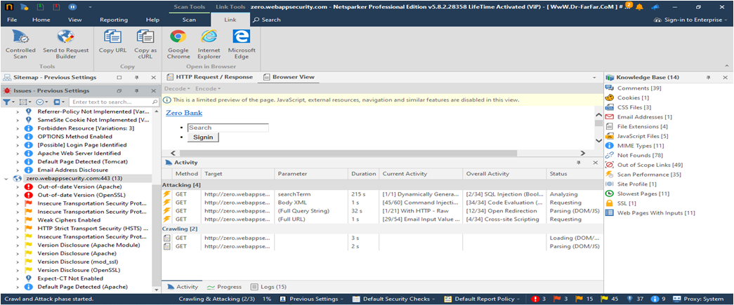
Netsparker Found Vulnerabilities

Slide 4
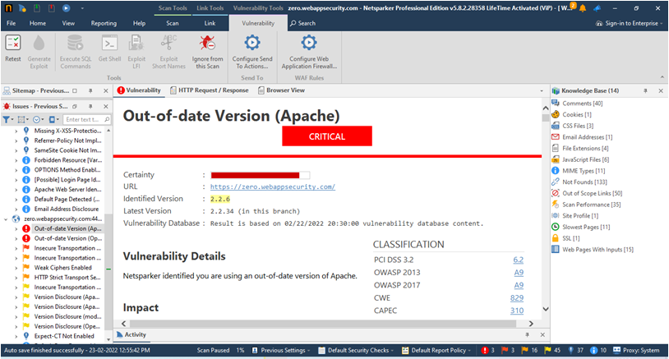
Netsparker Found Vulnerabilities

Slide 5
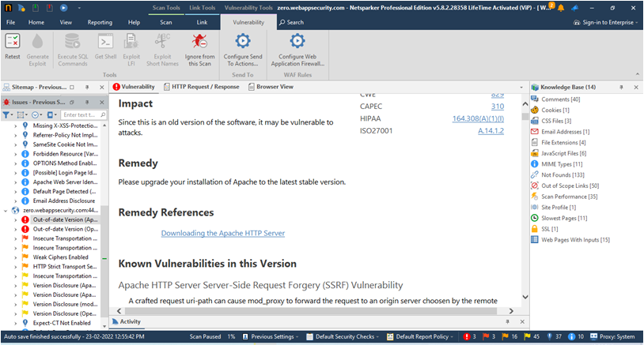
Netsparker Found Vulnerabilities

Slide 6
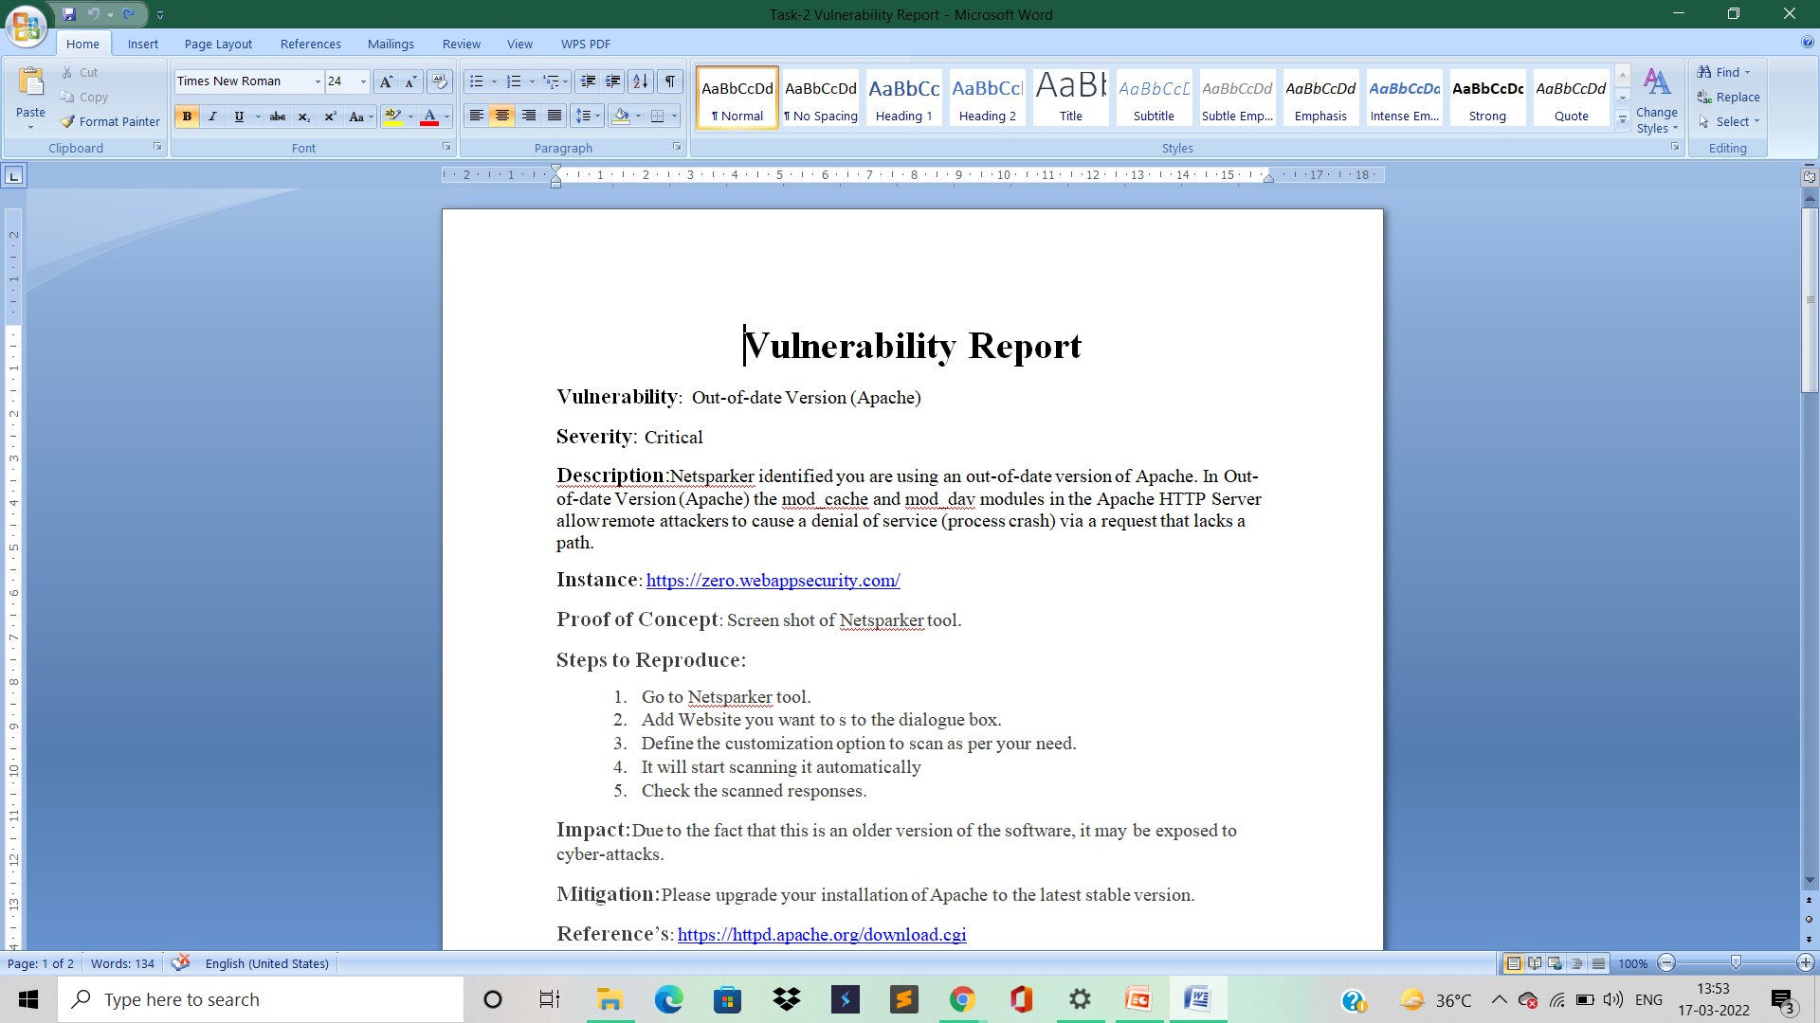
My Finding Vulnerabilities Report

Slide 7
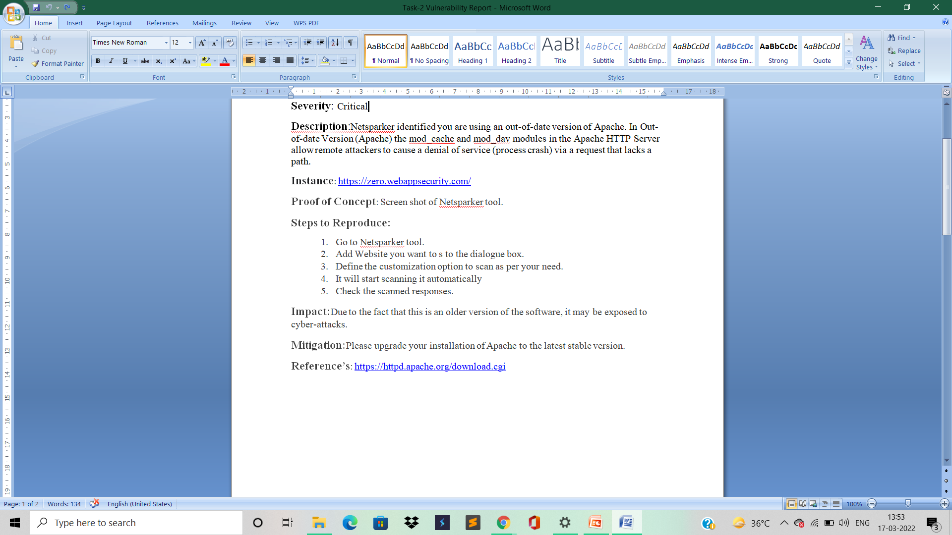
My Finding Vulnerabilities Report

